Slide 1

Copy number variation analysis from NGS data
Depth of coverage used to estimate copy number at a given position in the genome
variation in depth indicate copy number variants
Log R = read depth in the tumor sample normalized to read depth in the normal sample

Slide 2
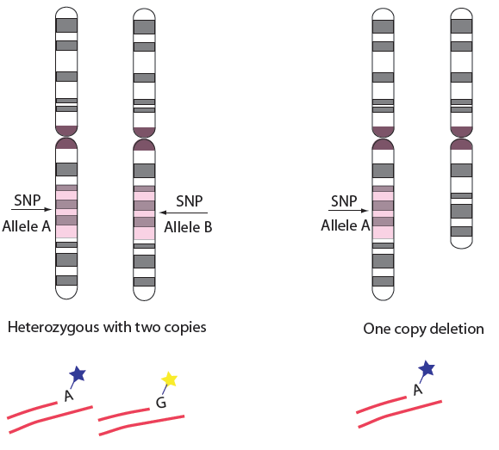
SNPs give allele specific information
Normal cells
cancer cell with deletion
A
B
B
B
A
A
A
A
A
N reads B
BAF =
0.5
1
N reads A + N reads B

Slide 3
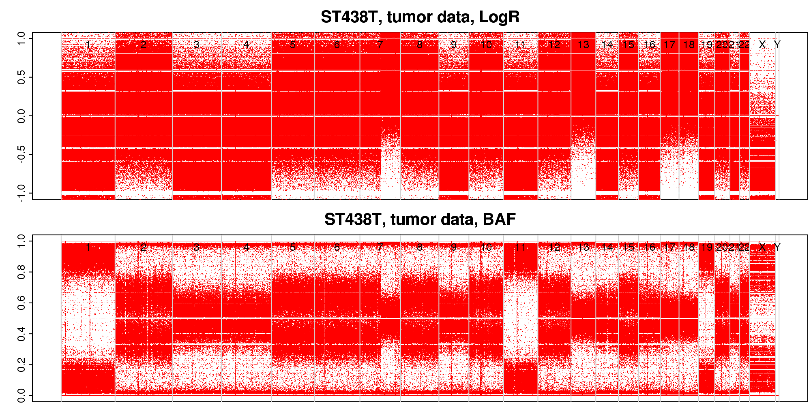
Example: Raw data tumor sample

Slide 4
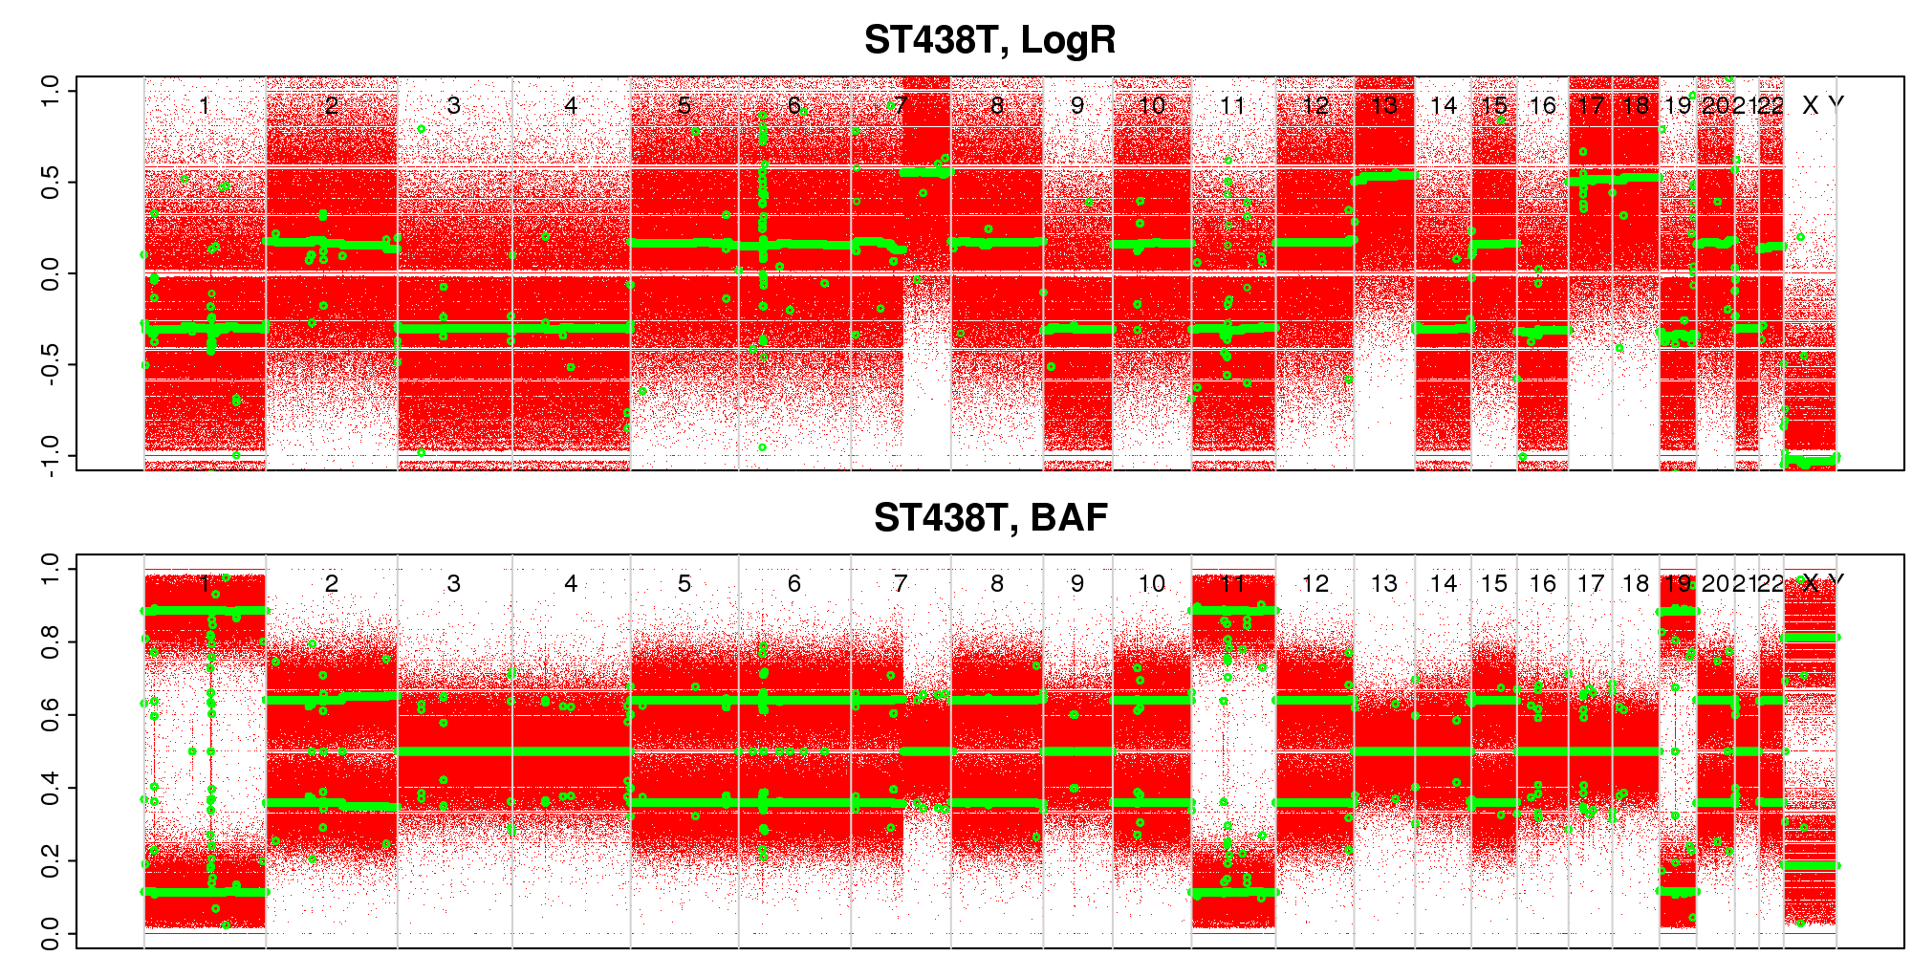
ASCAT
Gives allele specific copy number across the genome
Calculates average ploidy based on detected CNVs
Calculates average tumor purity by measuring how much the distribution of BAF values differ from what would be expected for 100% tumor cells.
BAF for tumor
Differs from the expected values
0 and 1
0.9
0.1

Slide 5
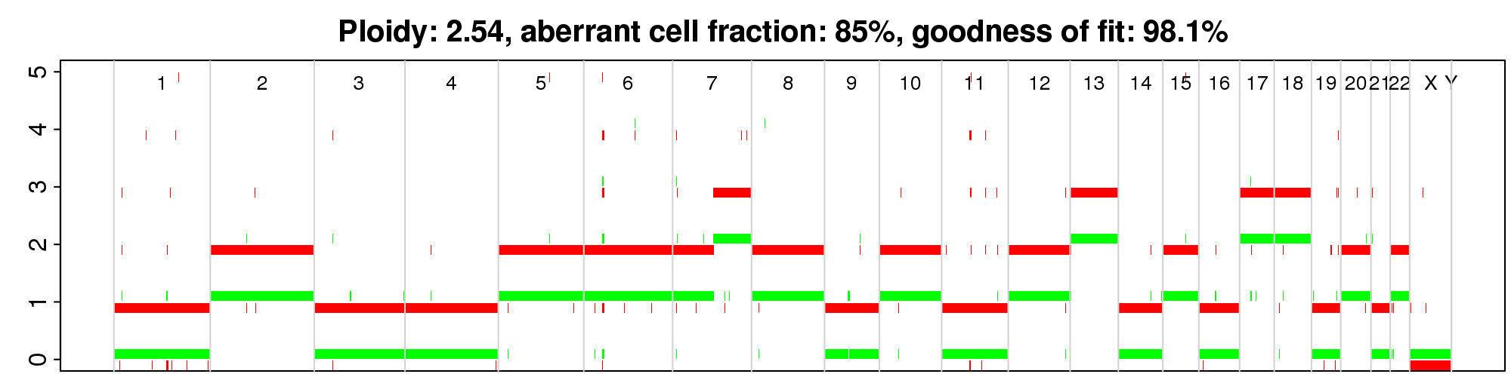
ASCAT fits a model of tumor purity and ploidy to the segmented data

Slide 6
My thoughts so far…
ASCAT usability OK – scripts in R easy to run
Runtime ok (a few hours on Milou)
ASCAT output useful – plots of raw data and segmented data very useful
Estimated copy number and ploidy model does not always “fit” with my interpretation of the plots
need more test data
Test other tools – FACETS , WAVER similar to ASCAT but developed for NGS data

